Slide 1

Budget Mate: Open Source Budget App
Final Presentation in Mobile Application
Jan Furio / 28.01.2024

Slide 2
Why another Budget App?
Values in %
7 Subscriptions
10 Personal Care Products
35 Rent/Mortgage
13 Clothing and Servicesg
Ausgaben für eine Person (monatlich)
https://www.nerdwallet.com/article/finance/monthly-expenses-single-person-family
15 Transport
20 Grocery Shopping

Slide 3
Why another Budget App?
https://www.businessofapps.com/data/google-play-statistics/
2.65Billion Apps on Google Play Store
about 90% Not FOSS
Low weight
76% Google AdMob and others
80/20 Rule
Offline? Nearly all apps require access to mobile data

Slide 4

Aims of BudgetMate
Minimal UI
BudgetMate uses Google's Material UI 3.0 to ensure a consistent design.
Offline-Functionality
By using the Room Database, all user data remains securely stored on the device.
Simple Navigation
The app features a navigation bar at the bottom of the screen, allowing for intuitive operation.
FOSS
The complete code for BudgIT is published on GitLab to demonstrate a commitment to FOSS (Free and Open Source Software) and give back to the community.
Budgeting
BudgetMate aims to help users manage their finances more effectively.

Slide 5

Functional Requirements
History
Integrated transaction history that can be manually entered, which must include a "label" and an "amount."
Fragments
The app should contain a Home Fragment, an Add Transaction Fragment, a Budget Fragment, and a Transaction Fragment.
Budget
The ability to manually enter the budget within the app. Each new entry should allow the input of an amount and frequency (options being "daily," "weekly," "fortnightly," "monthly," "yearly").
Infrastructure
The app stores the transactions and budget data within the Users device.
Home
The home screen should provide a clear overview of the user's financial status, featuring the last three transactions.

Slide 6
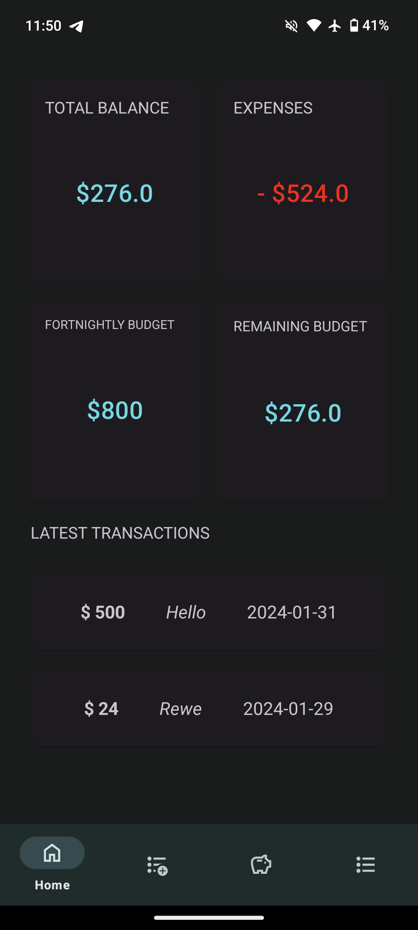
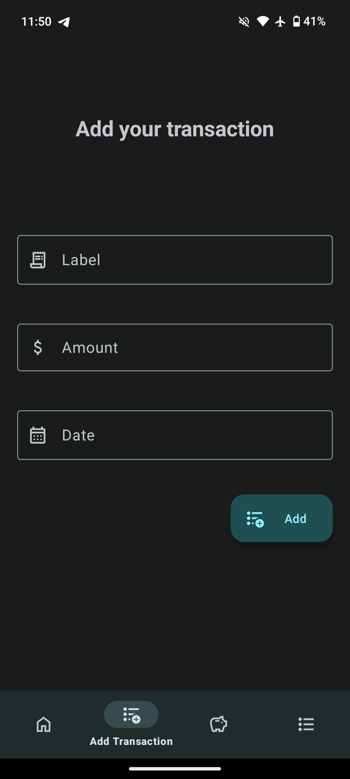
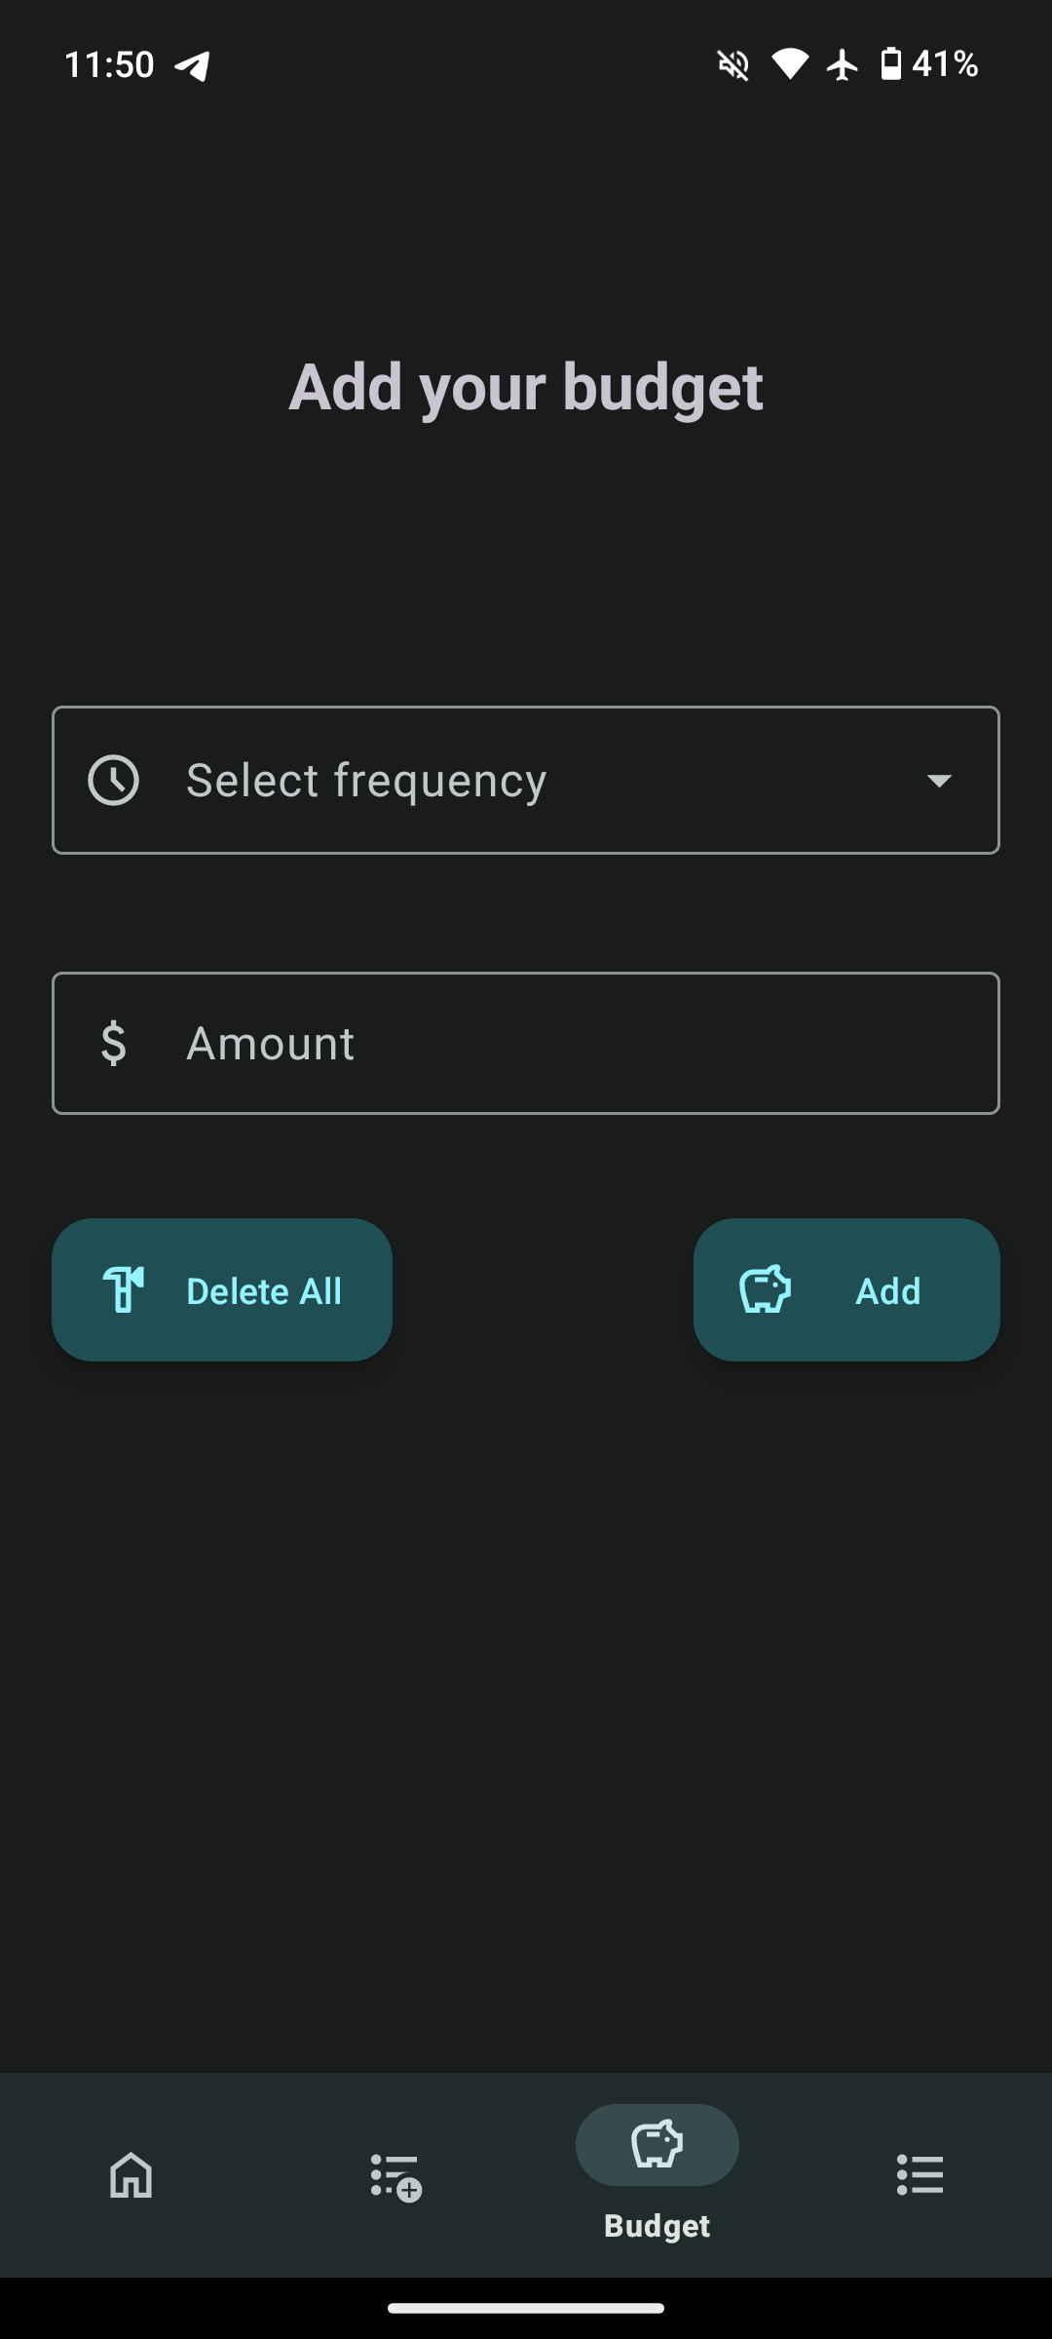
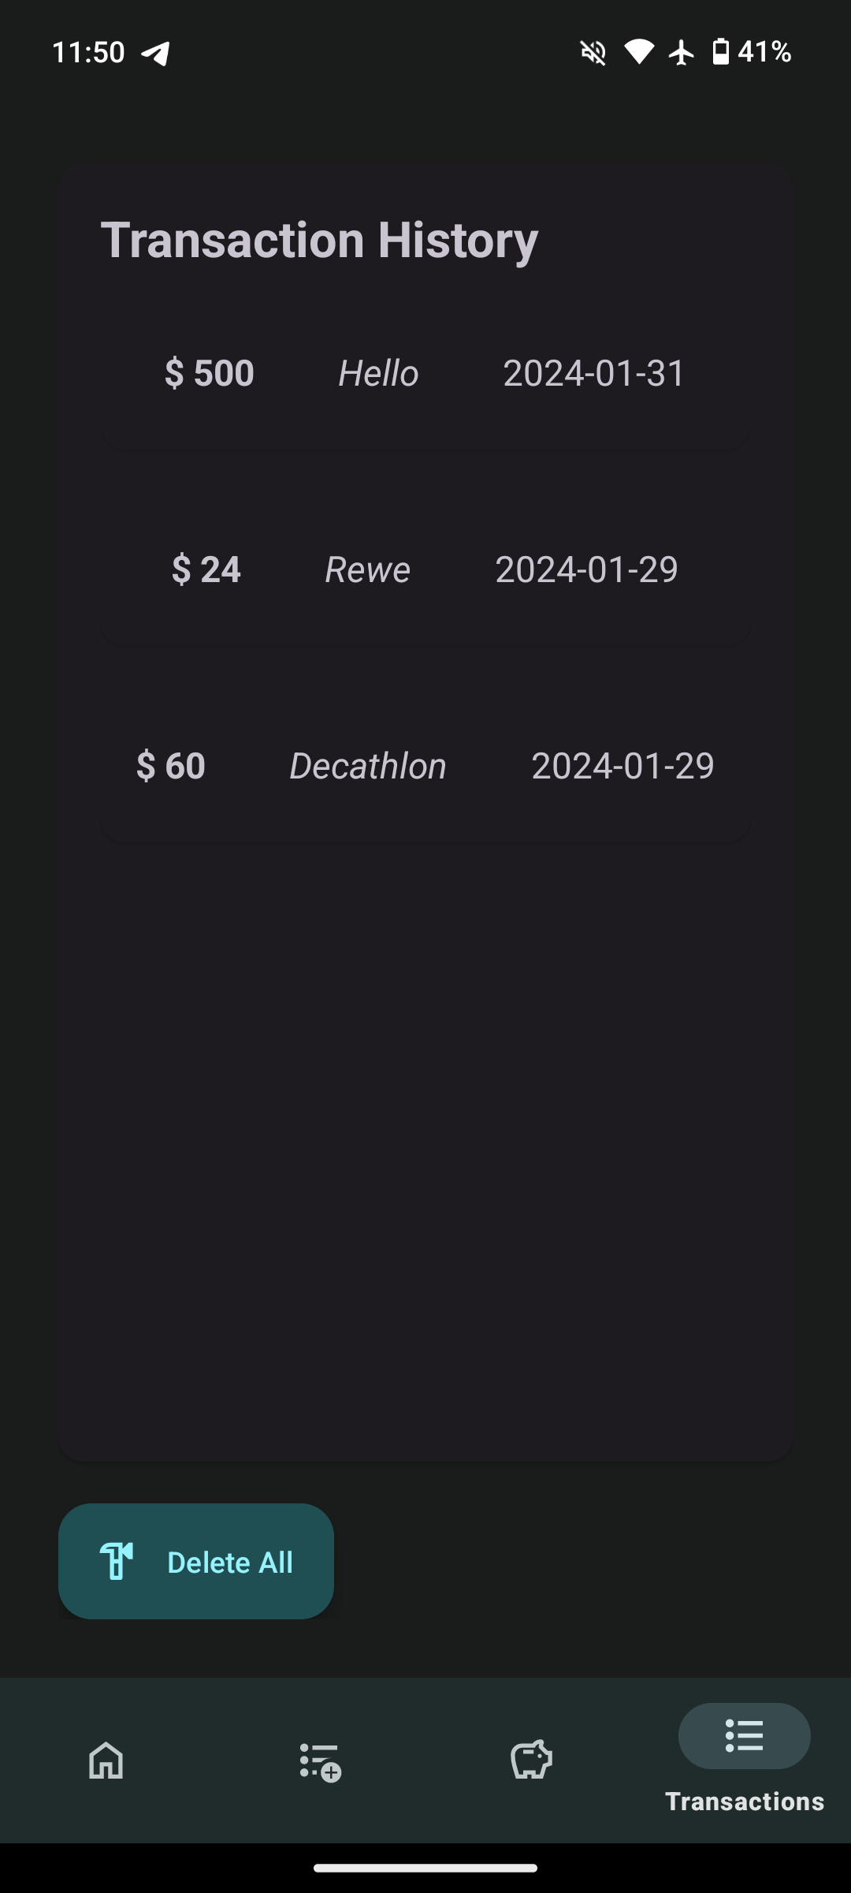
Fragments
Home
Overview of balance, expenses, and budget.
Add Transaction
Input form for new transactions.
Budget
Budget setting options.
Transaction Transaction list of transactions made with delete function.

Slide 7
Home
At a Glance
Displays the user's total balance, expenditures, budget, and remaining budget
Recent Transactions
Shows the latest transactions (sorted by date in descending order)

Slide 8
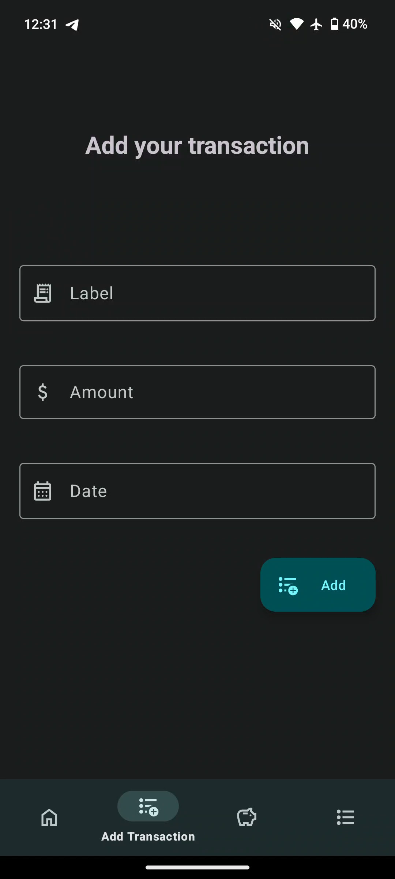
Add Transaction
Label
The user enters the transaction name as a string.
Amount
The user enters the amount as a double.
Date
Displays a Material 3.0 date pop-up, which is entered as a DateTime type.

Slide 9
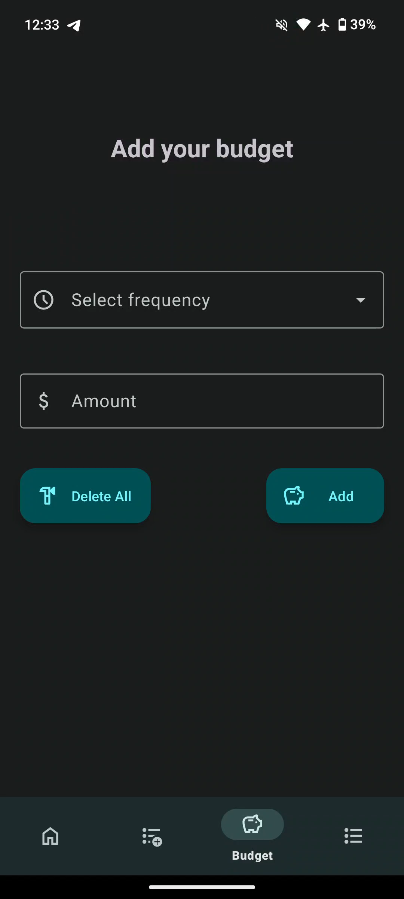
Budget
Select frequency
The user selects from the dropdown box between: daily, weekly, fortnightly, monthly, or yearly.
Amount
The user enters the amount of their new budget as a double.
Delete All
The user can delete all their entered and automatically generated budgets.

Slide 10
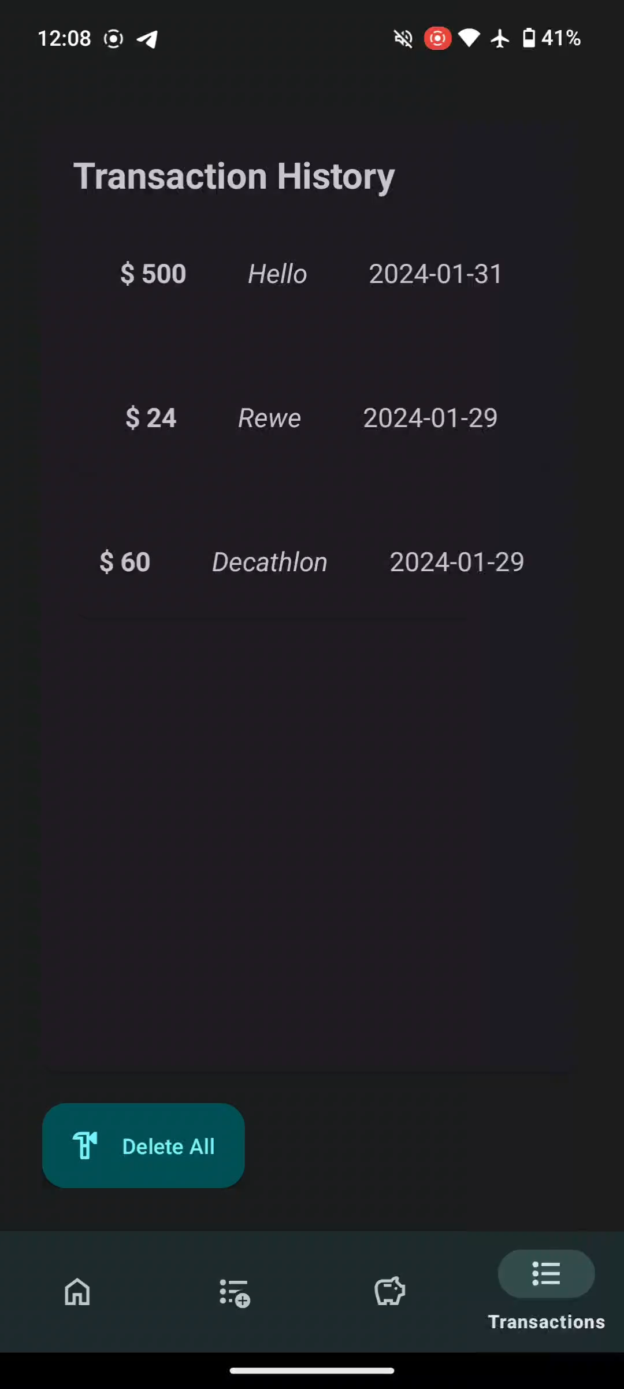
Transactions
Transaction History
All transactions added by the user are displayed here.
Swipe to Delete
Users can delete individual transactions with a right or left swipe gesture.
Delete All
Users can delete all transactions they have entered.

Slide 11
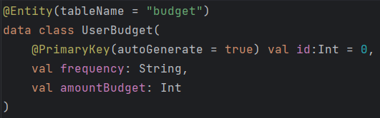
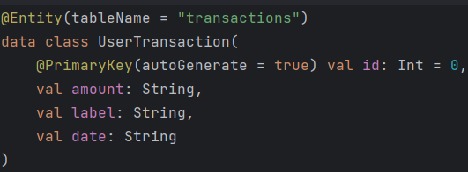
Database Structure
Budget Table
Has a PrimaryKey, stores the frequency as a string, and the budget amount as an Int.
Transactions Table
Has a PrimaryKey, stores the amount, label, and date as a string.

Slide 12

Thank You.

